Slide 1

Health Insurance Premium Prediction

Slide 2

Introduction
Health insurance premium prediction estimates the cost of health insurance coverage for individuals or groups.
Accurate premium predictions are crucial for insurance companies and individuals to make informed decisions and manage healthcare expenses effectively.
For insurance companies, accurate predictions support pricing, risk assessment, and financial planning.
For individuals, accurate predictions help with budgeting, plan selection, and comparing insurance options.

Slide 3
Data for Premium Prediction
Premium prediction uses data such as age, gender, location, health history, lifestyle habits, and coverage options.
Age, gender, and location influence healthcare costs and coverage availability.
Health history and lifestyle habits indicate individual health risks.
Coverage options impact the level of protection and cost-sharing.
A diverse and comprehensive dataset ensures accurate predictions by considering multiple factors and interactions.

Slide 4

Importance of Data Preprocessing
Data preprocessing is vital for machine learning tasks, including health insurance premium prediction.
It ensures data quality, consistency, and suitability for model training.
Key steps in data preprocessing include handling missing values, data normalization, and feature engineering.
Categorical variables are converted to numerical form using techniques like one-hot encoding.

Slide 5

Model Selection
Various regression models can be used for health insurance premium prediction.
The choice of the model depends on the dataset and specific requirements.
Linear regression is a common model used for premium prediction due to its simplicity and interpretability.
Other models like decision trees, random forests, or gradient boosting can also be considered based on the dataset and desired accuracy.

Slide 6

Training, Validation, and Testing
The dataset is split into three sets: training, validation, and testing.
The training set is used to train the model, while the validation set is used for hyperparameter tuning and model selection.
The testing set is kept separate and used for the final evaluation of the model's performance.
The validation set helps in adjusting the model's hyperparameters to improve its performance on unseen data.
Keeping the test set separate ensures a fair evaluation and unbiased estimation of the model's predictive capability.

Slide 7

Model Evaluation
Common evaluation metrics for premium prediction include mean squared error (MSE) and R-squared.
Mean squared error measures the average squared difference between predicted and actual premium values.
A lower MSE indicates better prediction accuracy, with zero being the best possible value.
R-squared represents the proportion of variance in the premiums explained by the model.
R-squared ranges from 0 to 1, with 1 indicating a perfect fit to the data.

Slide 8

Results and Conclusion
Show prediction results from the model, highlighting accuracy and effectiveness.
Accurate health insurance premium prediction has important implications:
Insurance companies can make informed pricing decisions and manage risks for profitability.
Individuals can plan and budget for healthcare expenses, select suitable insurance plans, and make informed financial decisions.

Slide 9

Health Insurance Premium Prediction with Machine Learning
The amount of the premium for a health insurance policy depends from person to person, as many factors affect the amount of the premium for a health insurance policy. Let’s say age, a young person is very less likely to have major health problems compared to an older person. Thus, treating an older person will be expensive compared to a young one. That is why an older person is required to pay a high premium compared to a young person.
Just like age, many other factors affect the premium for a health insurance policy. Hope you now have understood what health insurance is and how the premium for a health insurance policy is determined. In the section below, I will take you through the task of health insurance premium prediction with machine learning using Python.

Slide 10

The dataset that I am using for the task of health insurance premium prediction is collected from Kaggle. It contains data about:
the age of the person
gender of the person
Body Mass Index of the person
how many children the person is having
whether the person smokes or not
the region where the person lives
and the charges of the insurance premium
So let’s import the dataset and the necessary Python libraries that we need for this task:

Slide 11
import numpy as np
import pandas as pd
data = pd.read_csv("Health_insurance.csv")
data.head()
OUTPUT:
data.head()
age sex bmi children smoker region charges 0 19 female 27.900 0 yes southwest 16884.92400 1 18 male 33.770 1 no southeast 1725.55230 2 28 male 33.000 3 no southeast 4449.46200 3 33 male 22.705 0 no northwest 21984.47061 4 32 male 28.880 0 no northwest 3866.85520
Before moving forward, let’s have a look at whether this dataset contains any null values or not:

Slide 12
data.isnull().sum()
OUTPUT:
age 0 sex 0 bmi 0 children 0 smoker 0 region 0 charges 0 dtype: int64
The dataset is therefore ready to be used. After getting the first impressions of this data, I noticed the “smoker” column, which indicates whether the person smokes or not. This is an important feature of this dataset because a person who smokes is more likely to have major health problems compared to a person who does not smoke. So let’s look at the distribution of people who smoke and who do not:

Slide 13
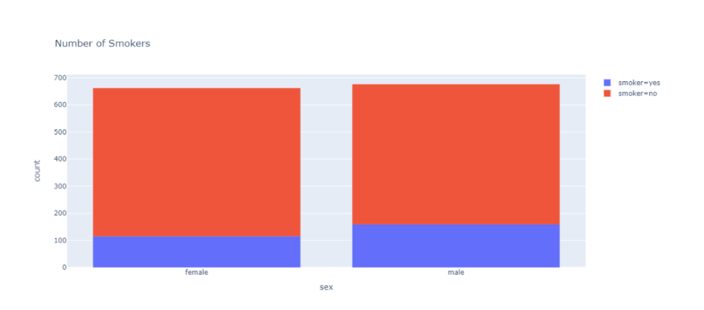
import plotly.express as px
data = data
figure = px.histogram(data, x = "sex", color = "smoker", title= "Number of Smokers")
figure.show()
OUTPUT :

Slide 14
According to the above visualization, 547 females, 517 males don’t smoke, and 115 females, 159 males do smoke. It is important to use this feature while training a machine learning model, so now I will replace the values of the “sex” and “smoker” columns with 0 and 1 as both these columns contain string values:
data["sex"] = data["sex"].map({"female": 0, "male": 1})
data["smoker"] = data["smoker"].map({"no": 0, "yes": 1})
print(data.head())
OUTPUT:
age sex bmi children smoker region charges 0 19 0 27.900 0 1 southwest 16884.92400 1 18 1 33.770 1 0 southeast 1725.55230 2 28 1 33.000 3 0 southeast 4449.46200 3 33 1 22.705 0 0 northwest 21984.47061 4 32 1 28.880 0 0 northwest 3866.85520
Now let’s have a look at the distribution of the regions where people are living according to the dataset:

Slide 15
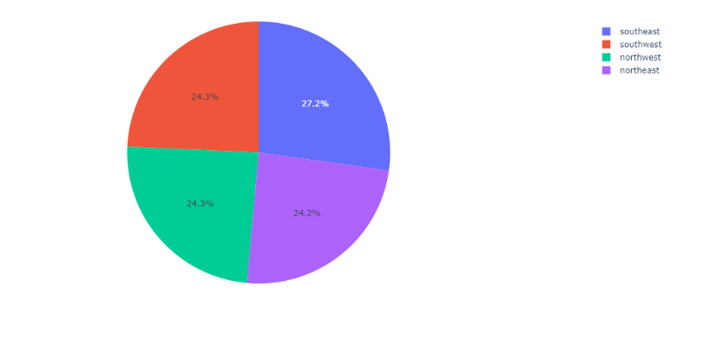
import plotly.express as px
pie = data["region"].value_counts()
regions = pie.index
population = pie.values
fig = px.pie(data, values=population, names=regions)
fig.show()
OUTPUT:

Slide 16
Now let’s have a look at the correlation between the features of this dataset:
print(data.corr())
OUTPUT:
age sex bmi children smoker charges age 1.000000 -0.020856 0.109272 0.042469 -0.025019 0.299008 sex -0.020856 1.000000 0.046371 0.017163 0.076185 0.057292 bmi 0.109272 0.046371 1.000000 0.012759 0.003750 0.198341 children 0.042469 0.017163 0.012759 1.000000 0.007673 0.067998 smoker -0.025019 0.076185 0.003750 0.007673 1.000000 0.787251 charges 0.299008 0.057292 0.198341 0.067998 0.787251 1.000000
Health Insurance Premium Prediction Model

Slide 17
Now let’s move on to training a machine learning model for the task of predicting health insurance premiums. First, I’ll split the data into training and test sets:
x = np.array(data[["age", "sex", "bmi", "smoker"]])
y = np.array(data["charges"])
from sklearn.model_selection import train_test_split
xtrain, xtest, ytrain, ytest = train_test_split(x, y, test_size=0.2, random_state=42)
After using different machine learning algorithms, I found the random forest algorithm as the best performing algorithm for this task. So here I will train the model by using the random forest regression algorithm:
from sklearn.ensemble import RandomForestRegressor
forest = RandomForestRegressor()
forest.fit(xtrain, ytrain)

Slide 18
OUTPUT:
RandomForestRegressor(bootstrap=True, ccp_alpha=0.0, criterion='mse', max_depth=None, max_features='auto', max_leaf_nodes=None, max_samples=None, min_impurity_decrease=0.0, min_impurity_split=None, min_samples_leaf=1, min_samples_split=2, min_weight_fraction_leaf=0.0, n_estimators=100, n_jobs=None, oob_score=False, random_state=None, verbose=0, warm_start=False)
Now let’s have a look at the predicted values of the model:
ypred = forest.predict(xtest)
data = pd.DataFrame(data={"Predicted Premium Amount": ypred})
print(data.head())
OUTPUT:
Predicted Premium Amount 0 11331.111753 1 5366.132261 2 28257.205036 3 9793.356425 4 34720.204296

Slide 19




So this is how you can train a machine learning model for the task of health insurance premium prediction using Python.
Summary
The premium amount of a health insurance policy depends on person to person as many factors affect the premium amount of a health insurance policy. I hope you liked this article on health insurance premium prediction with machine learning using Python. Feel free to ask your valuable questions in the comments section below.

